Slide 1
OOM MINI PROJECT
IIT2019228
IIT2019235
IIT2019238
IIB2019012

Slide 2
OOM Mini Project # 03: Development of 3D computer animations
AbstractThe following program demonstrates how the basic 3D transformations can beprogrammed in Java to show the movements of a 3D object. When the applet starts, a 2Dcube appears on the screen. When we press the drag mouse then cube performs rotationsin the direction in which the mouse was dragged and thus we can see the 2D renderedimage of the cube.

Slide 3
Use Case
Diagram

Slide 4
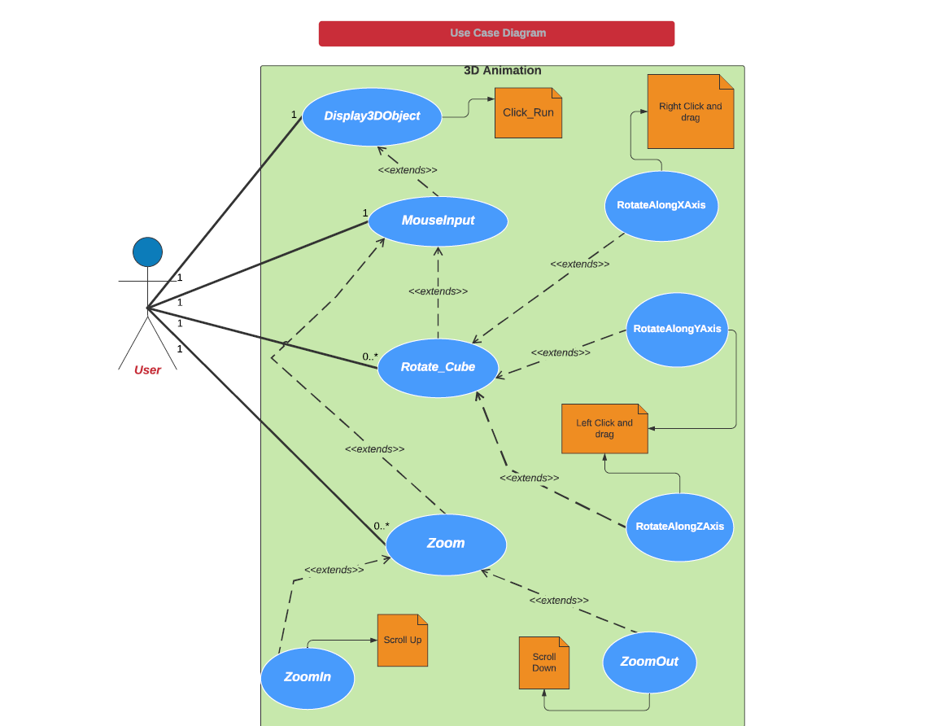

Slide 5
CRC
Diagrams

Slide 6
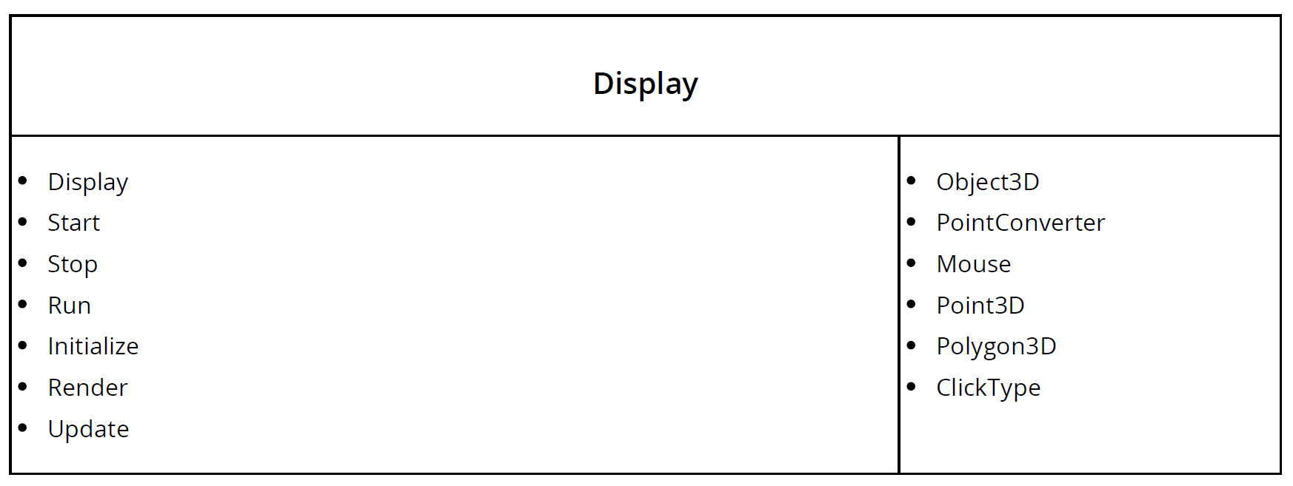

Slide 7
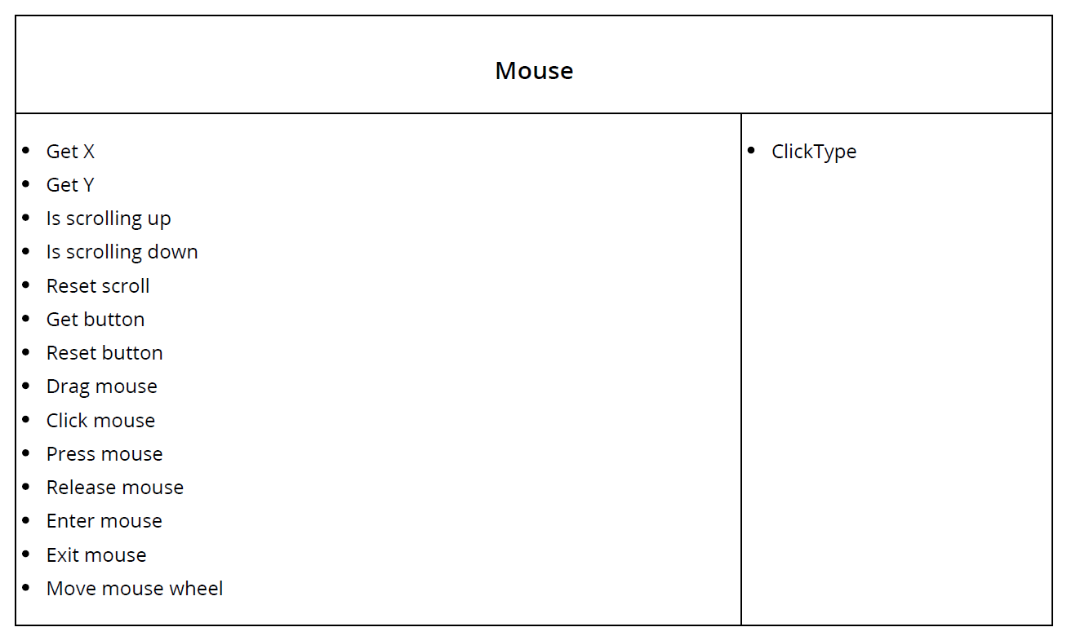

Slide 8
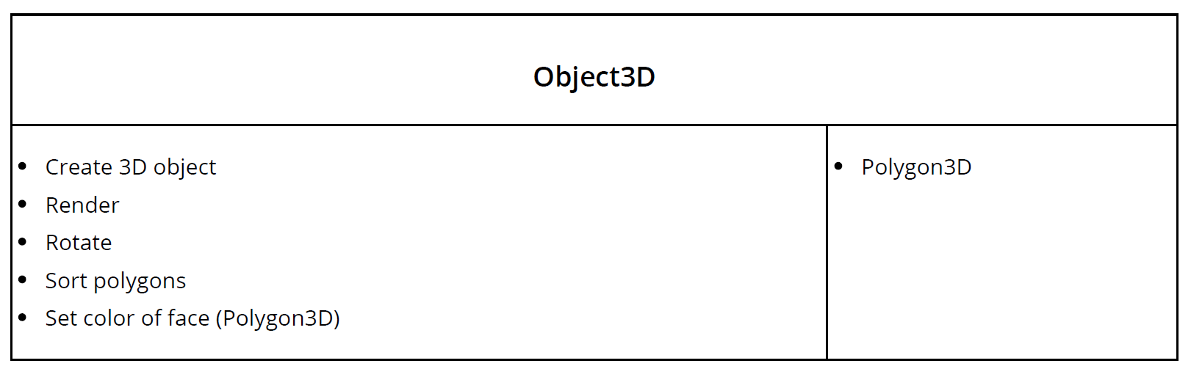
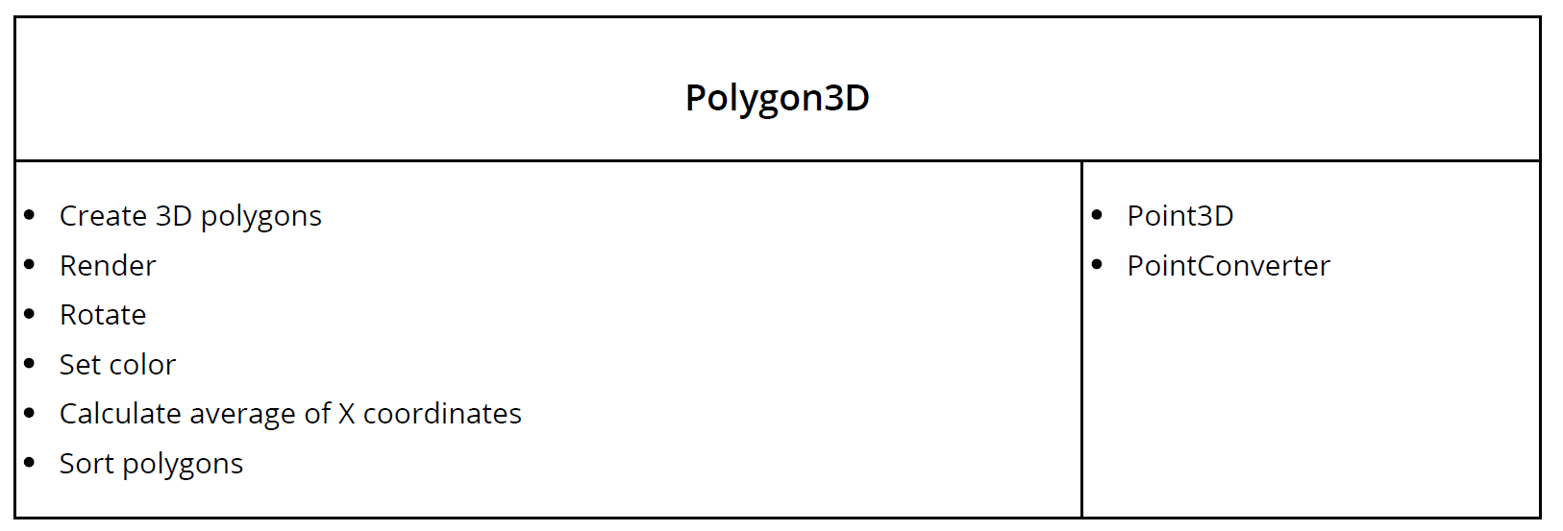

Slide 9
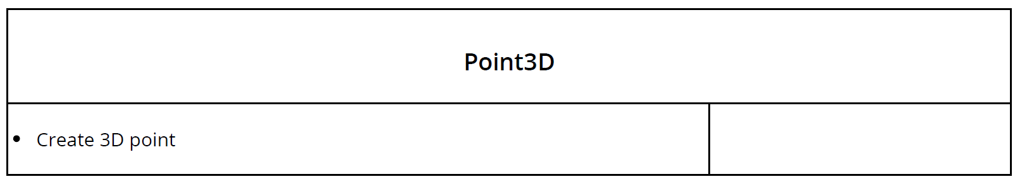
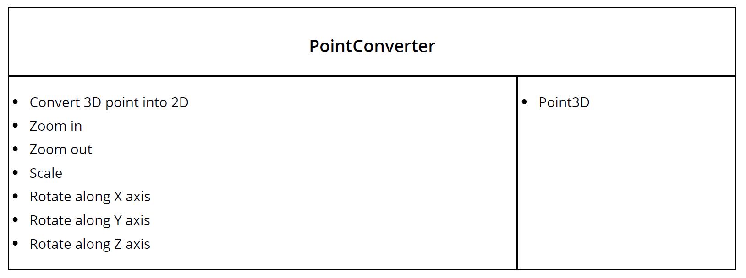

Slide 10


Slide 11
UML
Class
Diagram

Slide 12
https://app.lucidchart.com/invitations/accept/670c554f-55a1-4c3e-8904-f1e59b988a98
https://drive.google.com/file/d/1NBjX0CzdeDuFN4qYN4uSvEp-vtcOlAP2/view?usp=sharing

Slide 13
THANKS

